Slide 1

RADV Risk Adjustment Data Validation Tool
FHIRed UP
Augusto Burgos aburgos3@gatech.edu Spiro Ganas spiroganas@gmail.com Anja Guillory anjag1993@gmail.com Jamie Richgels jrichgels3@gatech.edu Daniel Stoneburner dstoneburner3@gatech.edu Tala Suidan tmsuidan@gatech.edu
Notes:
This presentation discusses the architecture and design of RADV, the risk adjustment data validation tool created by Team FHIRed Up.

Slide 2
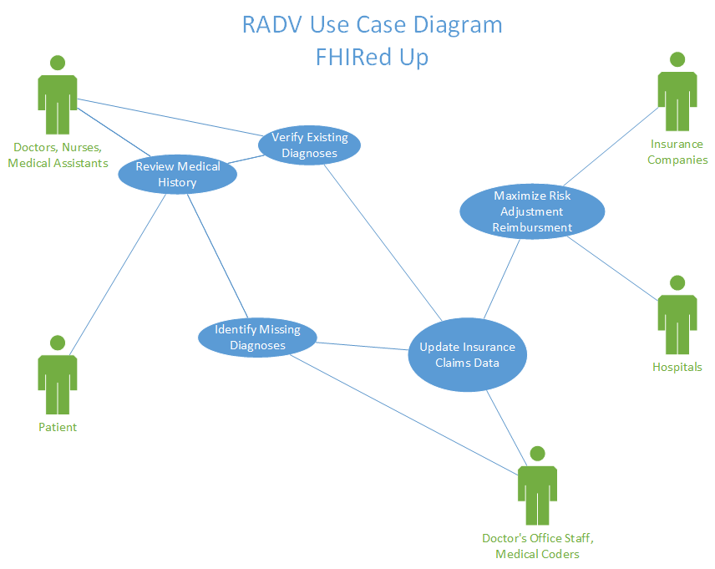
Notes:
RADV is designed to help Doctor’s, Hospitals and Insurance Companies maximize their risk adjusted reimbursements. Risk adjustment uses a patients medical history to determine their level of health. Providers who are caring for “sicker than average populations” receive greater payments. This use case diagram identifies users of the RADV system. Doctors and patients use the system to review a patients medical history. The doctor will then verify any existing diagnoses. The system then provides medical coders with data required to identify missing diagnoses and update the insurance claims data. Hospitals and insurance companies then use this corrected data to maximize their reimbursements.

Slide 3


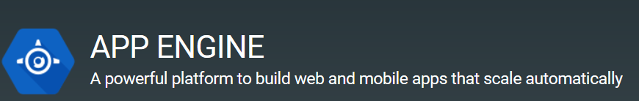
Implementation Tools & Languages
Data Tier
GaTech FHIR Server
Application Tier
Python Code
Presentation Tier
Google App Engine
HTML5
CSS
JavaScript
Notes:
The RADV tool follows the standard three-tier architecture. The data tier is Georgia Tech’s FHIR server. The application tier consists of business logic coded in the Python language. The presentation tier is and HTML5 website hosted on the Google App Engine platform. CSS was used to format the page, and JavaScript code was written to interact with the Application tier.

Slide 4
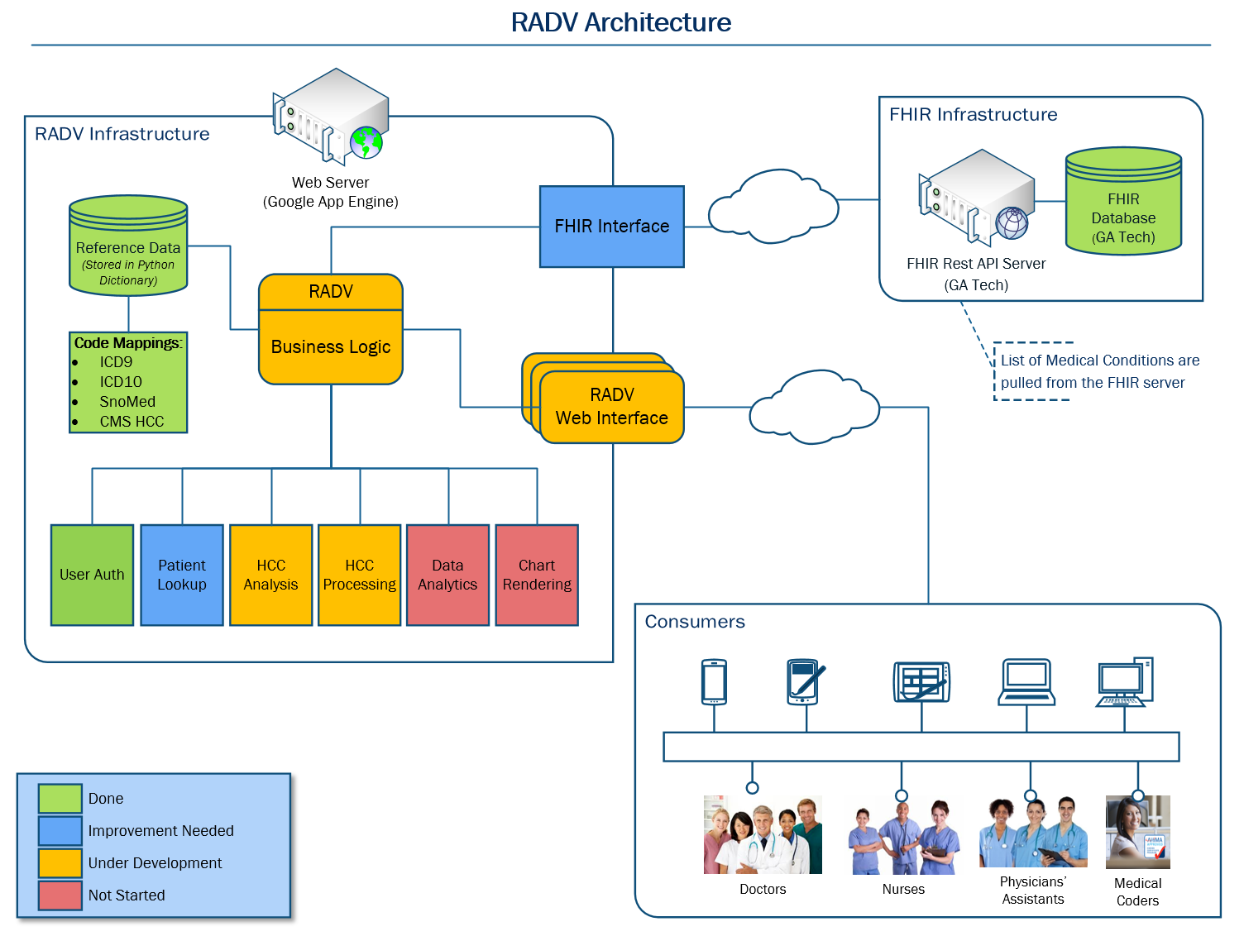
Notes:
This slide provides more details about the architecture of the RADV system. Data is stored and requested from Georgia Techs FHIR Server. A web server merges the FHIR data with reference tables and business logic. This produces information and data visualizations which are viewed by the end user through a website.

Slide 5
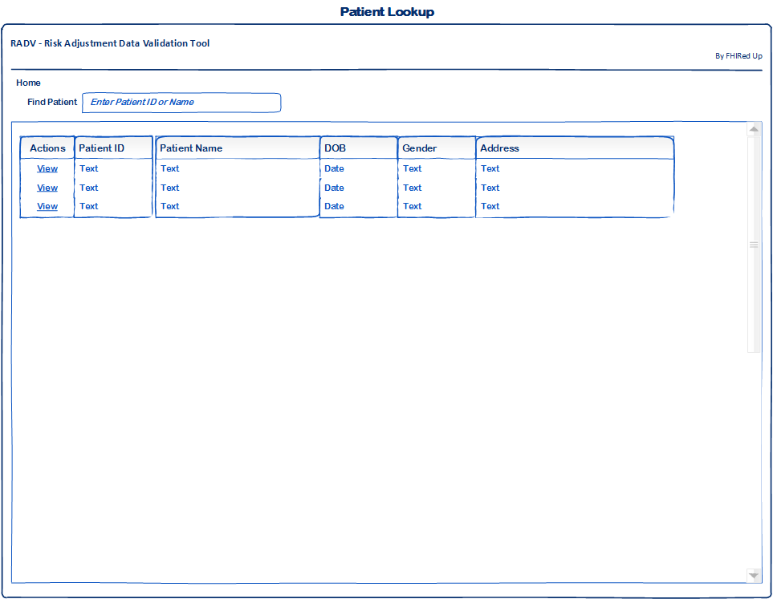
Wireframes – Patient Lookup
Notes:
The next 6 slides present the initial wireframe designs of the RADV tool highlighting the major pieces of functionality and user interaction.
Not presented is the authentication step required by the user in order to access this tool. Authentication and authorization of the user will be handled by existing well-defined protocols.
This wireframe shows how a user will lookup an existing patient. Users will be able to search by name or patient ID. A list of matching patients will be presented with additional patient data to assist in the selection of the correct patient.
Additional search options may be added such as gender, DOB and address.

Slide 6
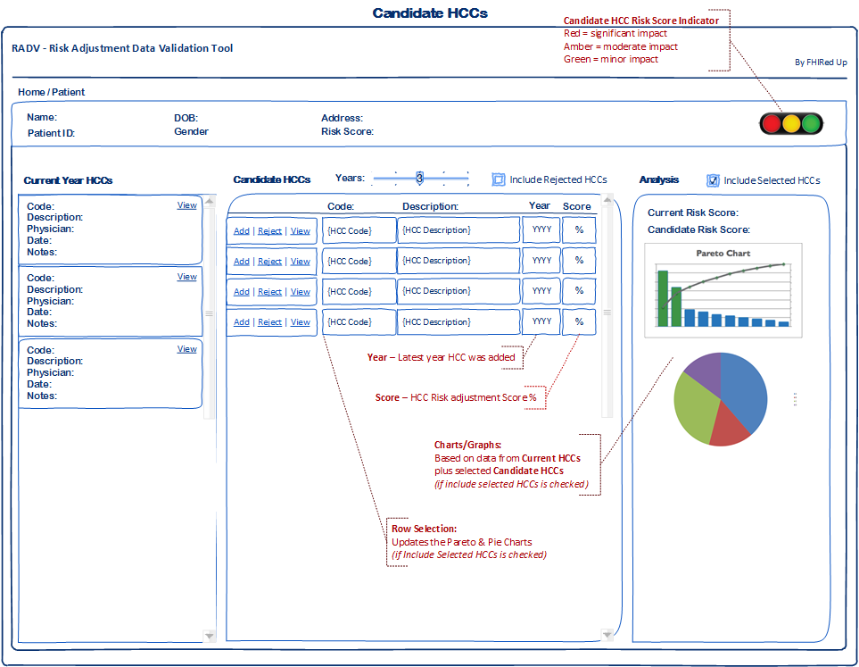
Wireframes – Candidate HCCs
Notes:
This wireframe presents the user with a list of candidate Hierarchical Condition Categories (or HCCs) that may be applicable to the selected patient. This view consists of 4 main sections.
The top section lists the patient name, Id, DOB and other pertinent identifying information. This section also shows the patient’s current risk adjust score along with an indicator displaying the potential impact of available candidate HCCs.
The left pane lists the existing HCCs applied during the calendar year with the ability to view additional details of each.
The middle pane lists candidate HCCs. For each HCC listed the following three criteria must be met 1st) It must have been applied to the patient in a prior calendar year; 2nd) it has not been applied during the current calendar year; and 3rd) It has not been rejected during this calendar year.
The list of candidate HCCs will provide information such as the latest year it was applied and the risk adjustment score %. Users will be able to Add, Reject each HCC or View its details with respect to the patient’s history. They will also be able to filter candidate HCCs based on the number of years since it was last applied to the patient.
Finally, the right pane presents the user with the patients overall risk adjustment score and two charts showing the relative impact of each HCC on that score. These charts will include the patient’s current HCCs and any selected Candidate HCCs allowing the user to immediately see the overall impact on the patient’s risk adjustment score. These charts are covered in more detail on slide 10.

Slide 7
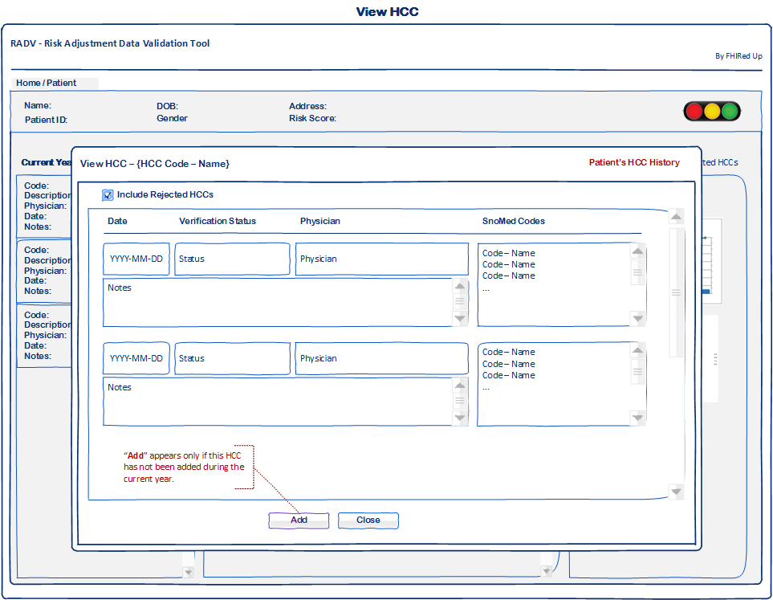
Wireframes – Viewing HCCs
Notes:
Clicking the view link on either a current or candidate HCC will present the user with this page which lists the patient’s medical history related to the selected HCC. This will include the verification status, physician who submitted the HCC, the date, notes and selected SnoMed codes.
As a convenience, if the HCC is considered a candidate then an “Add” button will be available.

Slide 8
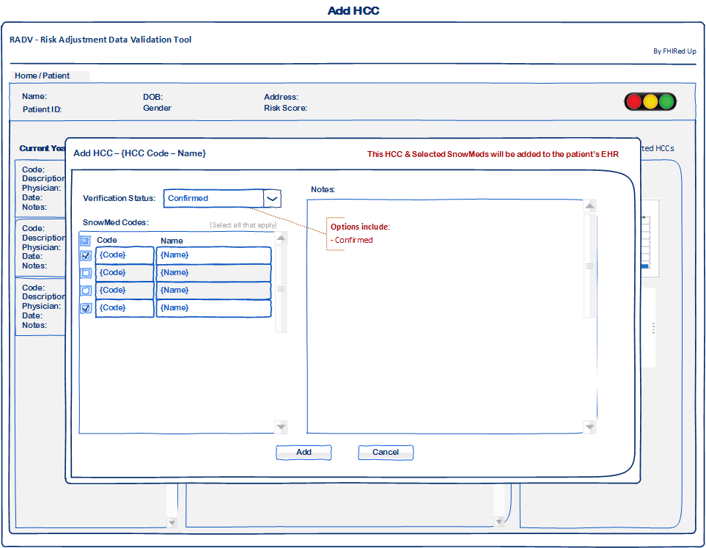
Wireframes – Adding an HCC
Notes:
Clicking the Add link on a candidate HCC will present the user with this form allowing them to select the verification status, applicable SnoMed codes and provide relevant notes.
Clicking the Add button will add this HCC to the patients record in the FHIR database.

Slide 9
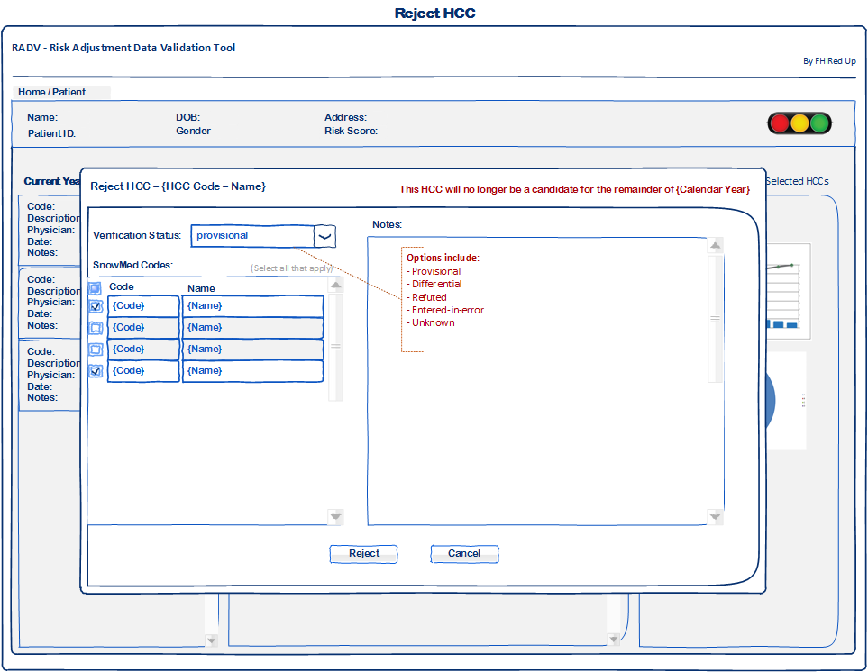
Wireframes – Rejecting an HCC
Notes:
Clicking the Reject link on a candidate HCC will present the user with this form allowing them to select the relevant verification status, applicable SnoMed codes and enter relevant notes regarding the rejection of this HCC.
Clicking the Reject button will add this HCC to the patients record in the FHIR database as a rejected HCC and will exclude it from the list of candidate HCCs for the remainder of the calendar year.

Slide 10
Data Analysis – Charts & Graphs
Notes:
This slide provide additional details on the patient risk score indicator and charts presented to the user.
The Candidate HCC risk score indicator allows the user to quickly determine whether a patient’s candidate HCCs, if added, would have a significant, moderate or minor impact on the risk adjustment score.
The pareto chart will show the relative impact of each current HCC along with any selected candidate HCCs.
The pie chart provides another perspective of the relative impact of each current HCC along with any selected candidate HCCs.

Slide 11
Updated Gantt Chart
* All team members involved † - Developers and testers involved ‡ - Business Analysts involved
Milestones and tasks in purple and dark blue are complete. Remainder are in progress or in the future
Notes:
Items to discuss:
This slide presents an updated Gantt chart
Scope is set until we ensure we make the most of its current reach
The First 2-week sprint is complete thanks to Augusto, Spiro, and Anja. The second sprint focuses on in-progress items and improvements. All team members are assisting in developing data visualizations for the next 2 week sprint.
Analysis for additional features within the scope is being done on a continual basis but only approved for each sprint in the middle of the preceding sprint. – mostly by Jamie and Tala
Code testing is occurring on a continual basis by Dan and other team members.
Documentation will start once product is close to complete at end of the 3rd sprint and will be completed a week after the 4th sprint.

Slide 12
Concerns & Other Issues
How to ensure doctor confirms or rejects candidate HCCs
Data Visualizations:
Enough to impact but not overwhelm the user.
Making charts informative and dynamic.
Notes:
There are currently two main concerns. The 1st is how we ensure the doctor confirms or rejects candidate HCCs and the 2nd deals with data visualizations. In particular we want to be sure there’s enough to impact but not overwhelm the user and make sure the charts are informative and dynamic.

Slide 13
References
Slide 3 Image from:
https://www.hl7.org/fhir/
https://www.python.org/
https://cloud.google.com/appengine
Slide 4 images from:
http://decompressionprosmarketing.com/blogs/decompression-pros/16891112-how-to-ask-for-referrals-from-medical-doctors
http://www.libertynursingagency.com/
http://allhealthcare.monster.com/training/articles/1822-5-steps-to-becoming-a-medical-assistant
http://greenfieldcc.3dcartstores.com/Medical-Coding-and-Billing_p_1058.html

